Slide 1
1.3 Text, sound and images
Compression

Slide 2
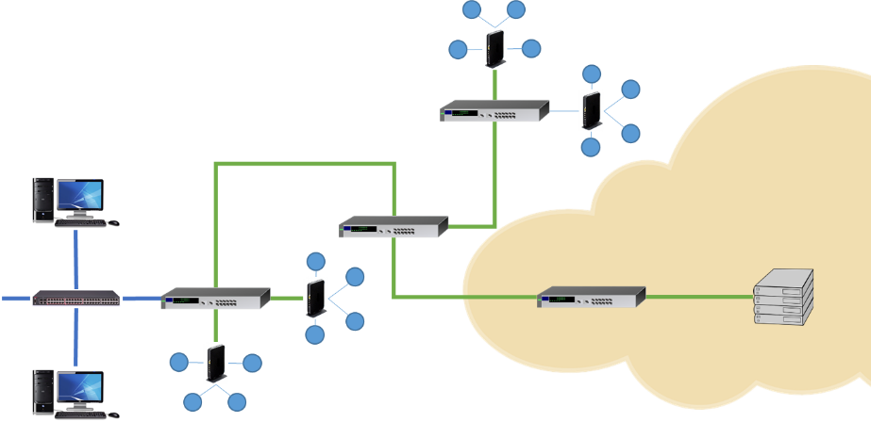

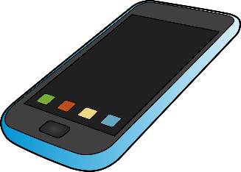


Why we use compression
Compression reduces the size of a file so it takes up less space, helping to maximise the amount of data we can store on our devices.
Smaller files are also quicker to transfer or stream over the internet.

Slide 3
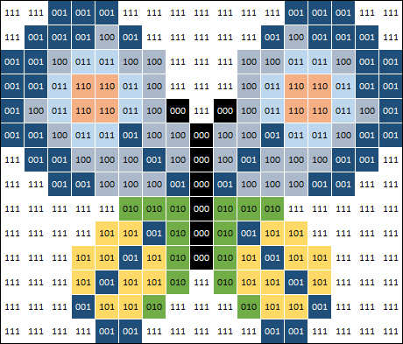
Compression techniques
With an image, the number of colours increases the file size – this is because we need more bits per pixel to store a greater range of possible colours.

Slide 4
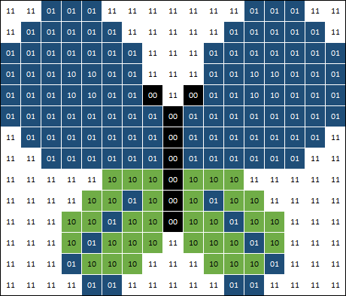
Compression techniques
One way to make a file smaller would be to store a lower number of colours – alternatively, we can store larger areas of pixels as one colour.

Slide 5
Compression techniques
One way to make a file smaller would be to store a lower number of colours – alternatively, we can store larger areas of pixels as one colour.
Both techniques reduce the quality of the image, which is why they are referred to as lossy compression.

Slide 6

Lossy compression techniques
Original image
100% quality
2.2MB
Lossy compressed JPEG file
70% quality
89 KB

Slide 7

Lossless compression
As the name suggests, lossless compression does not cause any data to be lost during the process.

Slide 8
Lossless compression
As the name suggests, lossless compression does not cause any data to be lost during the process.
In this image, there are large areas of white pixels. Instead of storing every pixel with the same binary pattern, we could store the binary for white followed by the number of contiguous white pixels in a row.

Slide 9


Lossless compression
Does not work well with full colour photographs
Works well with images that have large areas of contiguous colour

Slide 10
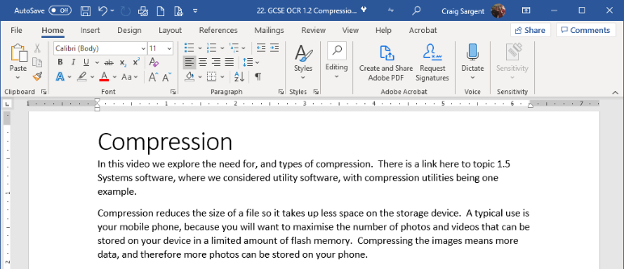
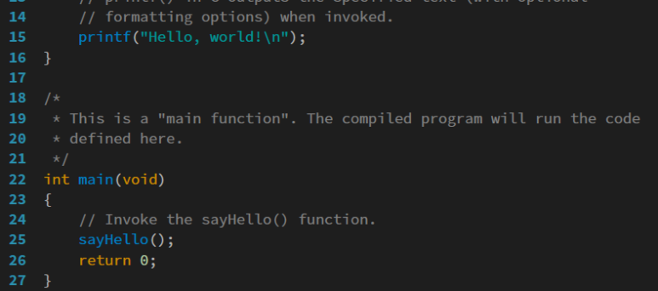
Suitability of lossy and lossless compression
Some types of files are not suitable for lossy compression.
Text documents and executable code must be compressed in their entirety to avoid losing essential data.
For these file types, we must use lossless compression so we can revert the file back to its original state.

Slide 11

Why we use compression
Compression is used to reduce the size of a file so it requires less:
Bandwidth
Storage space
Transmission time
Lossy compression:
Some data is lost and cannot be recovered.
Greatly reduces file size.
Reduces the quality of images/sound.
Suitable for images, sound and video.
Cannot be used with text or executable files.
Lossless compression:
No data is lost, just encoded differently.
Files are recovered to their original state.
Can be used with all types of data.
Less effective at reducing file size.
Most suitable for text documents and executable files.

Slide 12


